Slide 1


Board Member Orientation
January 14, 2026

Slide 2



Agenda
Please Ask Questions Throughout
Who Are We – who is the Connecticut Green Bank
What Do We Do – what programs does the Connecticut Green Bank oversee
Why Do We Do It – why is increasing investment in the green economy important

Slide 3

Board Member Orientation
Who Are We

Slide 4
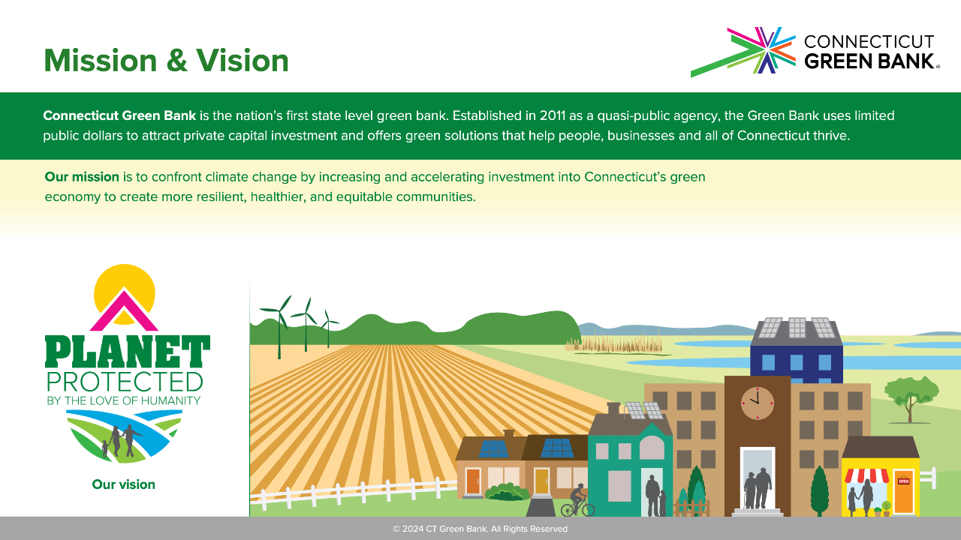
© 2025 CT Green Bank. All Rights Reserved

Slide 5
Connecticut Green Bank
About Us
Quasi-Public Organization – created through Section 99 of Public Act 11-80 (i.e., CGS 16-245n), and the successor to the Connecticut Clean Energy Fund
Focus – finance “clean energy” (e.g., renewable energy, energy efficiency, electric vehicles) and “environmental infrastructure” (e.g., climate adaptation and resilience, land conservation, agriculture, waste and recycling, etc.) projects
Revenues – from a variety of sources, including:
  Public Revenues – Clean Energy Fund (“CEF”) is a $0.001/kWh surcharge on electric bills (i.e., System Benefit Fund), which is about $7-$10 per family per year, and generates $25MM; and Regional Greenhouse Gas Initiative (“RGGI”) allowance proceeds up to $5.2MM
  Earned Revenues – interest income from investments; Renewable Energy Credit (“REC”) sales; program cost recovery (i.e. Energy Storage Solutions (“ESS”)); federal grants and loans (e.g., GGRF from EPA, RESP from USDA); and other sources

Slide 6
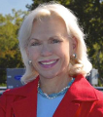
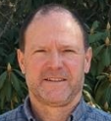
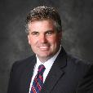
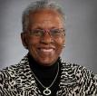

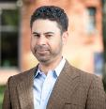



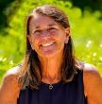
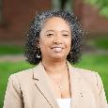

Connecticut Green Bank
Board of Directors
Board of Directors
Committee Chairs
Chair
Lonnie Reed
Former State Rep.
Vice Chair
Joe DeNicola
DEEP
(ex-officio)
Member
James Cosgrove
Town of Branford
AC&G
Tom Flynn
Coral Drive Partners
Member
Adrienne Farrar Houël
Greater Bridgeport Community Enterprises
Member
Thomas Flynn
Coral Drive Partners
Member
Dominick Grant
Dirt Capital Partners
BO&C
John Harrity
Connecticut Roundtable on Climate and Jobs
Member
John Harrity
Connecticut Roundtable on Climate and Jobs
Member
Kim Mooers
Treasurer
(ex-officio)
Member
Allison Pincus
DECD
(ex-officio)
Deployment
Joe DeNicola
DEEP
Member
Lisa Shanahan
Town of Norwalk
Member
Brenda Watson
North Hartford Partnership
Member
Joanna Wozniak Brown
OPM
(ex-officio)
Joint CEEF-CGB
Brenda Watson
North Hartford Partnership
REFERENCES
Established Board of Directors as of January 1, 2026. AC&G = Audit, Compliance and Governance Committee. BO&C = Budget, Operations and Compensation Committee.

Slide 7






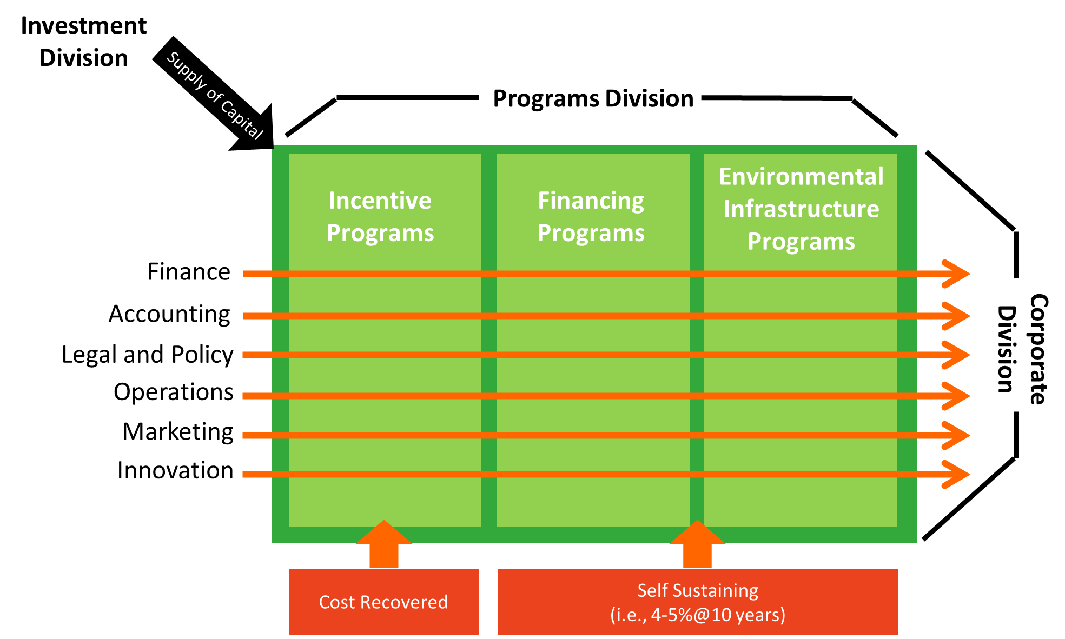






Connecticut Green Bank
Organizational Structure – Leaders

Slide 8

Board Member Orientation
What Do We Do

Slide 9
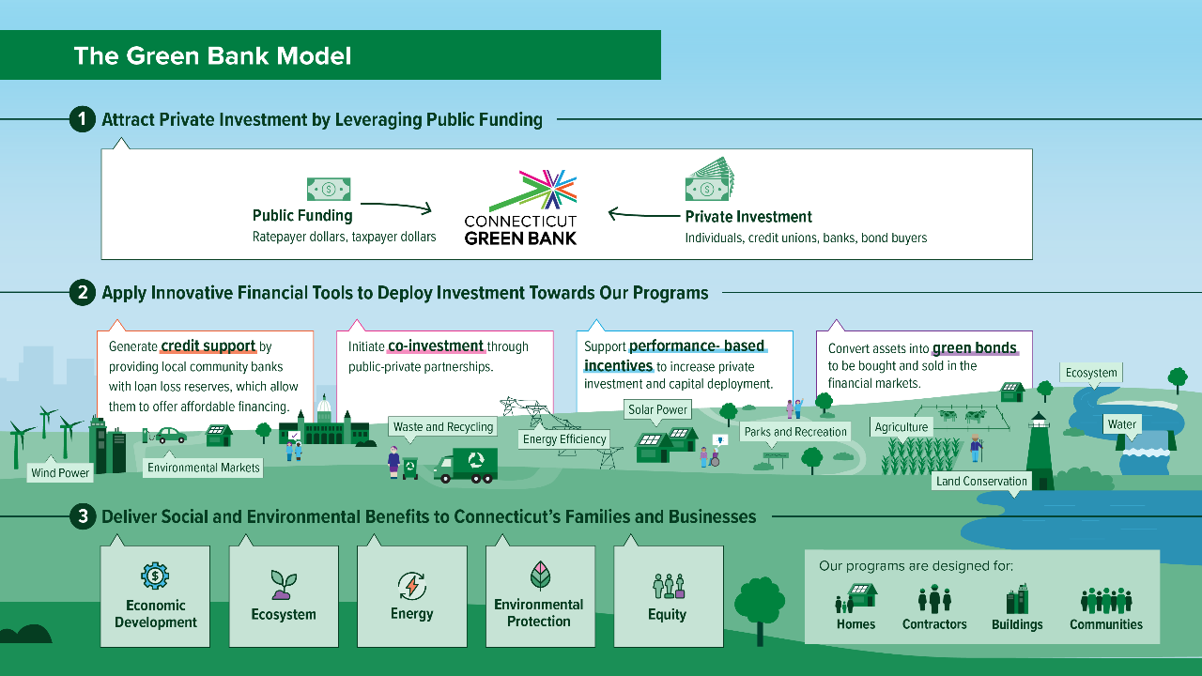

Slide 10
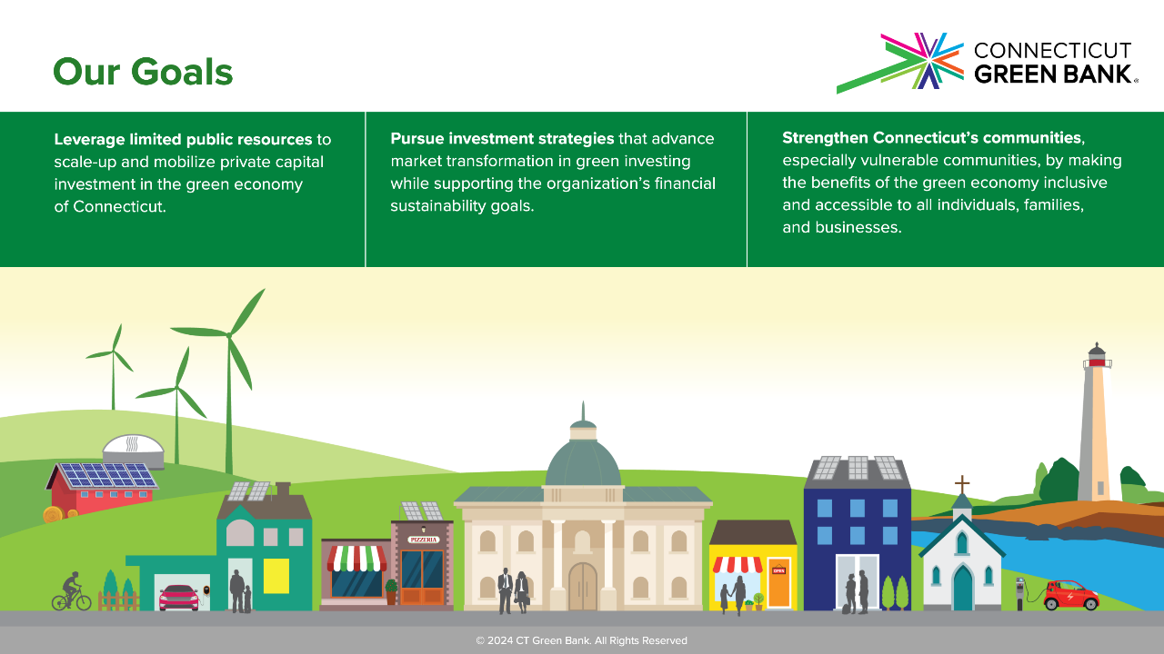
© 2025 CT Green Bank. All Rights Reserved

Slide 11
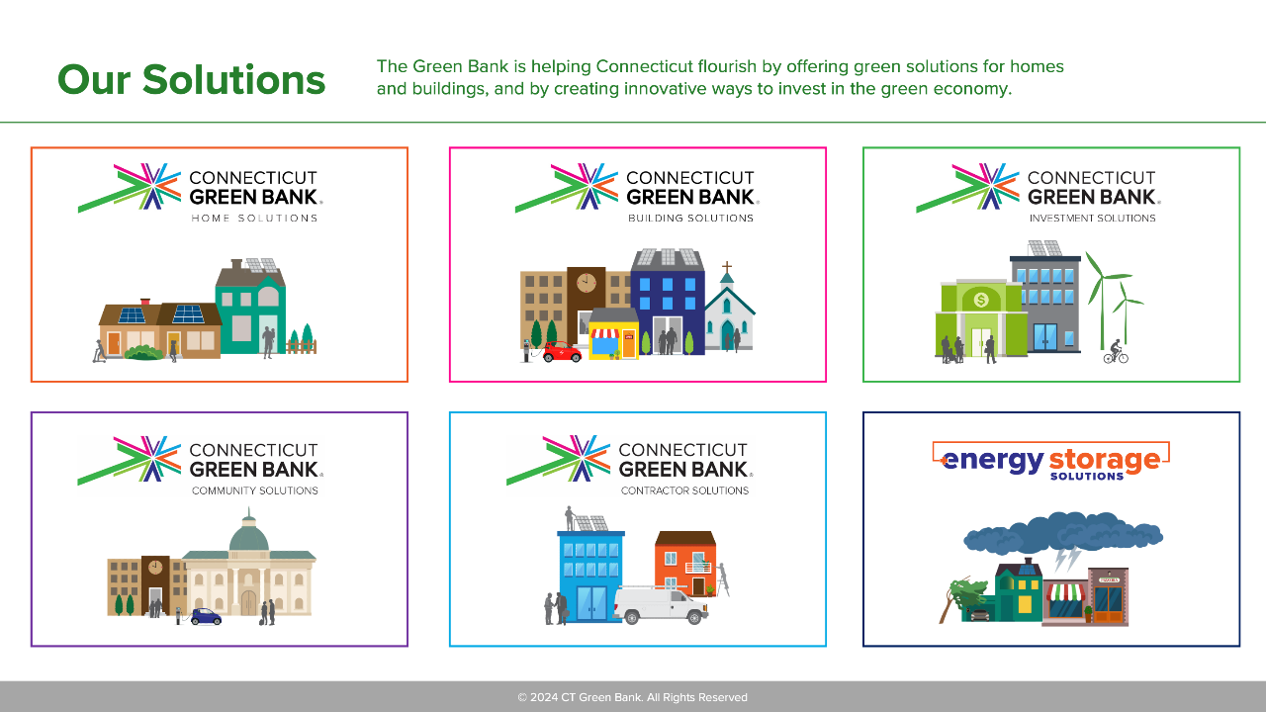
© 2025 CT Green Bank. All Rights Reserved

Slide 12

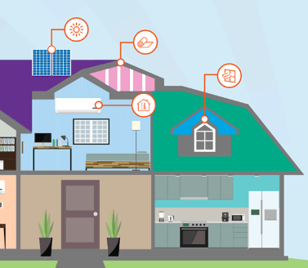

Home Solutions – Credit Support
Smart-E Loan
Market Segment | Residential Single Family (Credit Support – IRB, LLR)
Organizational Structure | Financing Programs and Investments
Technology | Clean Energy (e.g., weatherization, heat pumps, HVAC, solar, storage, EV rechargers) and Environmental Infrastructure (e.g., FORTIFIEDTM Roof, lead pipes, septic tanks, waterproofing, tree removal)
Product Summary | Partnership with local community banks and credit unions to provide easy access to affordable financing for comprehensive clean energy and environmental infrastructure measures. 5-20-year terms at rates ranging from 4.49-7.49% for $500-$50,000 of borrowing.
Support Needed | Provide 2nd Loan Loss Reserve (LLR) up to 7.5% of losses Class A and 15.0% of losses Class B
CT Results | 9,675 projects for $201.0 MM investment, 17.5 MW solar PV, 84% projects have EE
REFERENCES
Annual Comprehensive Financial Report FY 2025

Slide 13
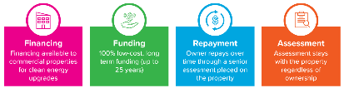

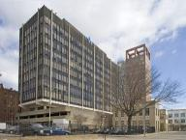
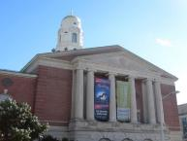

Building Solutions – Co-Investment
Commercial Property Assessed Clean Energy
Market Segment | Commercial, Industrial, Nonprofit and Multifamily
Organizational Structure | Financing Programs and Investments
Technology | Clean Energy (e.g., weatherization, heat pumps, HVAC, solar, storage, fuel cells, hydro, EV chargers, etc.) and Resilience
Product Summary | Commercial Property Assessed Clean Energy (“C-PACE”) applies a benefit assessment to a property to finance “clean energy” improvements with SIR>1, including resilience (i.e., without SIR requirement)
Support Needed | Capital to finance clean energy improvements Contractors to install clean energy improvements Supportive municipality – 139 opted in Supportive mortgage lender
CT Results | 429 projects for $392.3 MM investment, 54.4 MW of RE, 29% projects have EE
REFERENCES
Annual Comprehensive Financial Report FY 2025

Slide 14
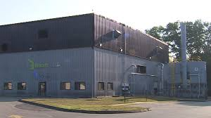

Community Solutions – Co-Investment
Green Bank Capital Solutions
Market Segment | Infrastructure (Investment)
Organizational Structure | Environmental Infrastructure Programs and Investments
Technology | Environmental Infrastructure – Organic Waste and Agriculture
Project Summary | Provided $1.3MM 10-year subordinated loan (first lien on thermal oxidizer) at 5.5% interest rate (i.e., 18-month interest only payments) to finance food waste to animal feed facility
Support Needed | Links to food waste collection policy (PA 11-127) Senior debt of $3.7MM from private capital for facility and equipment with $1.3MM subordinated debt from Green Bank for oxidizer to increase capacity of the facility
CT Results | Process over 14,000,000 tons of food waste over 10 years, which is equivalent to over 14 MTCO2 avoided

Slide 15
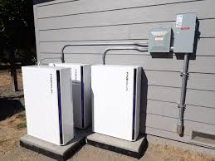
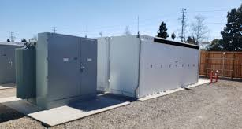
Energy Storage Solutions
Performance Based Incentives
Market Segment | Residential and Non-Residential (Performance-Based Incentives)
Organizational Structure | Incentive Programs
Technology | Clean Energy – Battery Storage
Project Summary | Co-administered with the EDCs to provide performance-based incentives for behind the meter installations of battery storage for resilience and peak demand reduction to achieve 580 MW of deployment by 2030
Support Needed | Links to battery storage policy (PA 21-53) Administrative costs and incentives are cost recovered through RAM proceedings
CT Results | Residential – 1,261 projects approved for 14.5 MW of which 638 projects and 8.2 MW are complete Non-Residential – 72 projects approved for 142.9 MW of which 5 projects and 0.8 MW are complete
REFERENCES
Energy Storage Solutions Performance Report – as of January 12, 2026 - https://energystoragect.com/ess-performance-report/

Slide 16
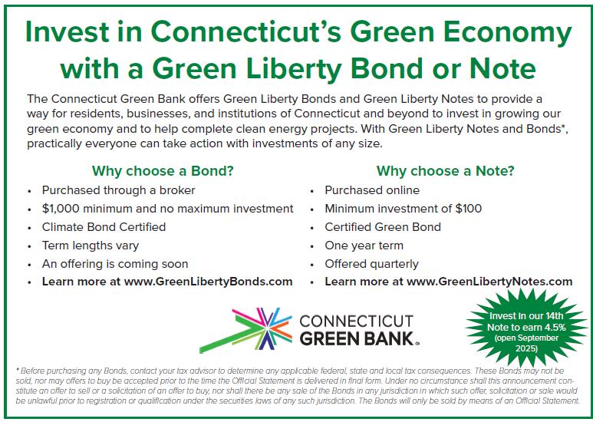

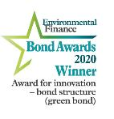
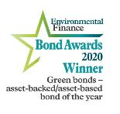
Investment Solutions – Green Bonds
Green Liberty Notes
Two great investment options
14th Green Liberty Note is open
Details on a Green Liberty Bond can be found through a Preliminary Offering Statement
Visit greenlibertybonds.com or greenlibertynotes.com for more

Slide 17

Board Member Orientation
Why Do We Do It

Slide 19
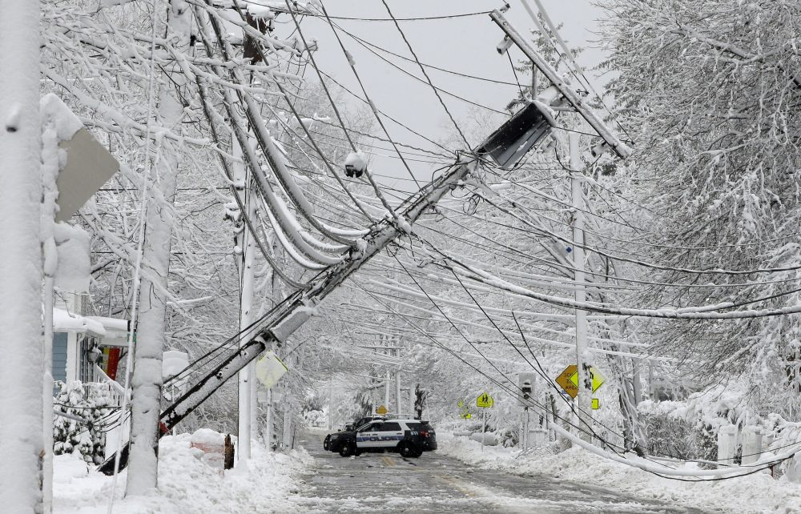

Slide 20
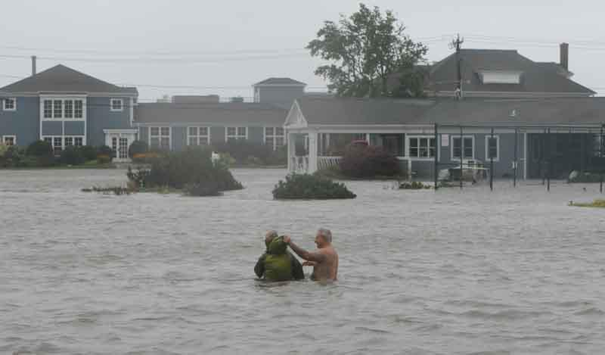

Slide 21
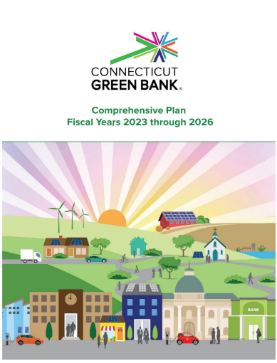
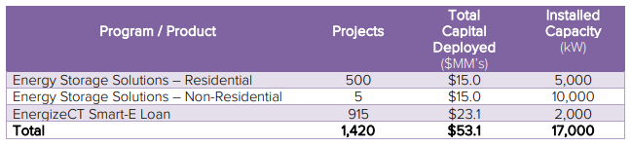
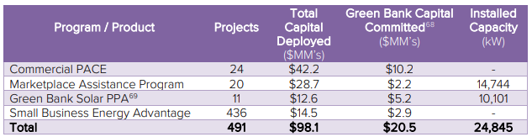
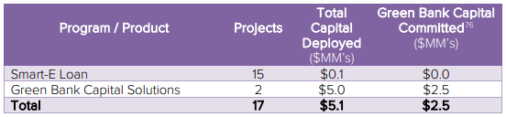
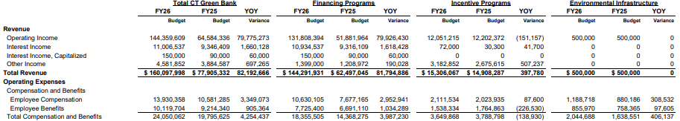
Comprehensive Plan
Click Here

Slide 22
Governance
Resolutions of Purposes – BOD adopted resolution outlining purposes, “clean energy” and “environmental infrastructure” definitions, and qualify as a Community Development Financial Institution (“CDFI”)
Bylaws – articles outlining governance of the organization (i.e., CGS 16-245n), including Joint Committee (CGS 16-245m(d)(2))
Operating Procedures – overview of governance, administration, budget and operations, personnel policies, property, contracting for services, and financial assistance (i.e., competitive, programmatic, or strategic)
Ethics Policy – ethical conduct for Board and Staff, and statement, including requirement to file annual Statement of Financial Interests

Slide 23
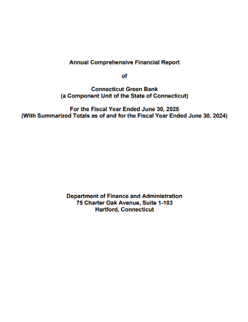
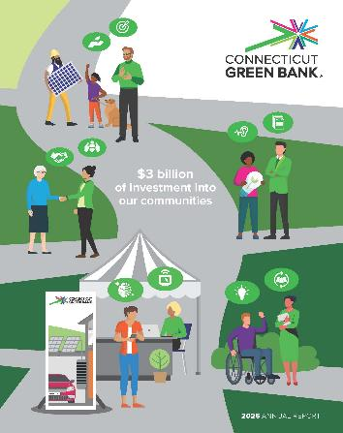
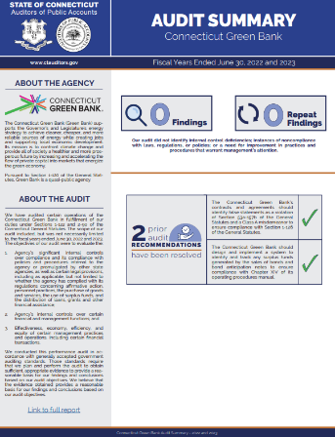

Financial and Non-Financial Reporting
Annual Comprehensive Financial Report
Click Here
Annual Report
Click Here
Auditors of Public Account Bi-Annual Audit
Click Here

Slide 24

Social and Environmental Reporting
FY12
FY25
Since the Connecticut Green Bank’s inception through the bipartisan legislation in July 2011, we have mobilized more than $3.11 billion of investment into the State’s green economy.
To do this, we used $463.3 million in Green Bank dollars to attract $2.65 billion in private investment, a leverage ratio of $6.70 for every $1. The impact of our deployment of renewable energy and energy efficiency to families, businesses, and our communities is shown in terms of:
Economic Development
Energy
Environmental Protection
Equity
Video – Click Here
Infographic Fact Sheet – Click Here

Slide 25
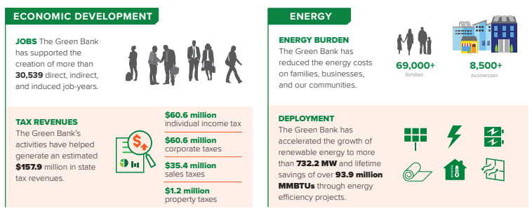
Economic Development and Energy…
By the Numbers

Slide 26
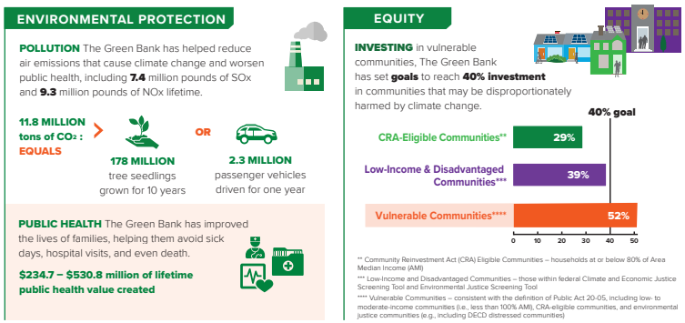
…Environmental Protection and Equity
By the Numbers

Slide 27
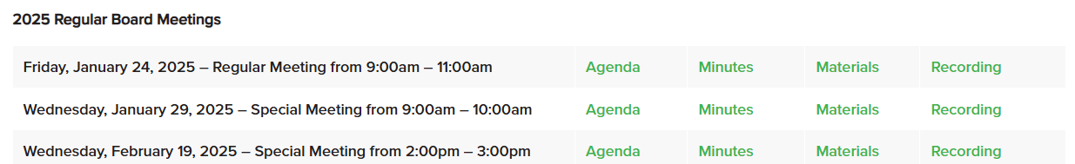

Transparency
Board Meetings – open to the public through Secretary of State website, and accessible materials on Board and Committee meetings by Green Bank website:
Open Connecticut – Checkbook and Payroll level transparency
Quarterly Webinars – engage 75-100 stakeholders throughout the year in seasonal online webinars
Public Engagement – participate in legislative and regulatory hearings, community events, and industry gatherings

Slide 28
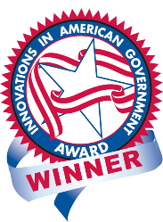
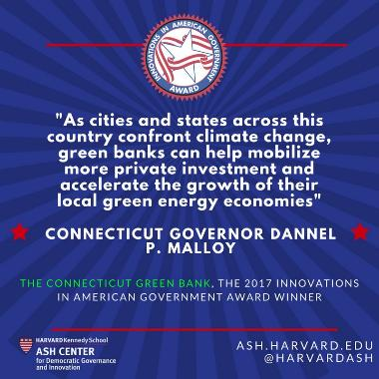
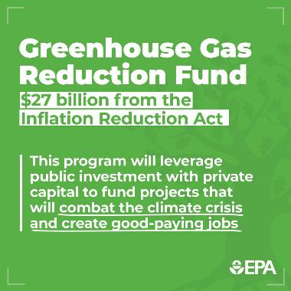

Leader of Green Bank Movement
From the state model to national policy

Slide 29


Thank you for serving on the Board!

